Slide 3
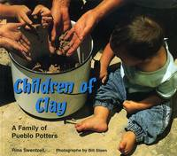
Lerner’s “We Are Still Here” nonfiction series

Slide 4
Sneve’s First Americans series, published by Holiday House

Slide 5
American Indian Contributions to the World series (5 books)
Food, Farming, and Hunting
Trade, Transportation, and Warfare
Science and Technology
Medicine and Health
Buildings, Clothing, and Art

Slide 6
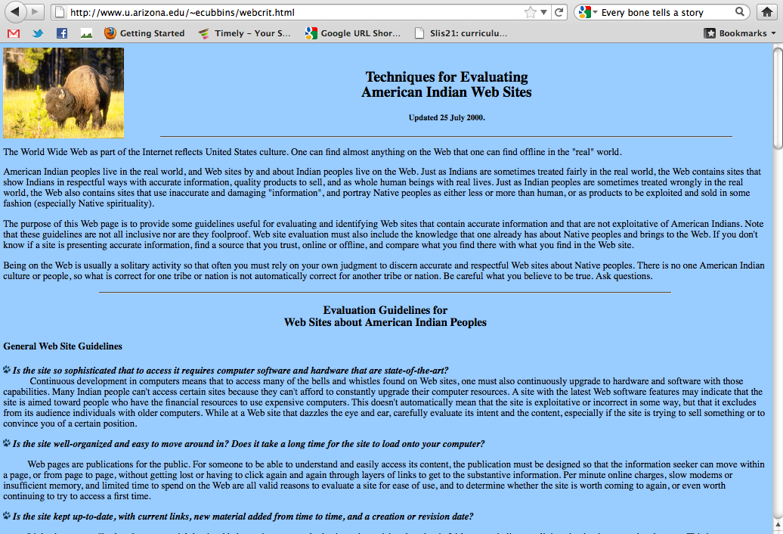

Slide 7
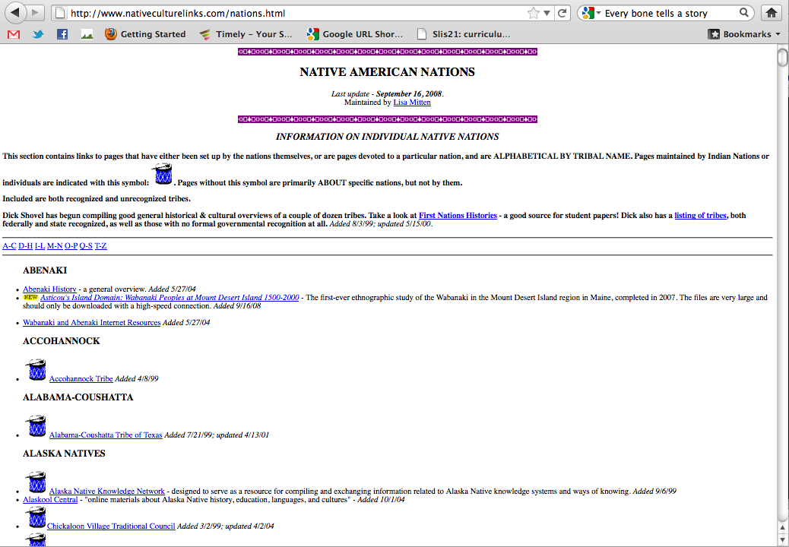

Slide 8
Helpful books for professional development

Slide 9
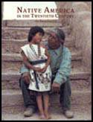
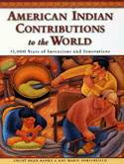
Must-have encyclopedias. Older publication years, but reliable! Get used copies!

Slide 10
Native awards…
American Indian Library Association
Lacapa Spirit Prize
Wordcraft Circle

