Slide 1
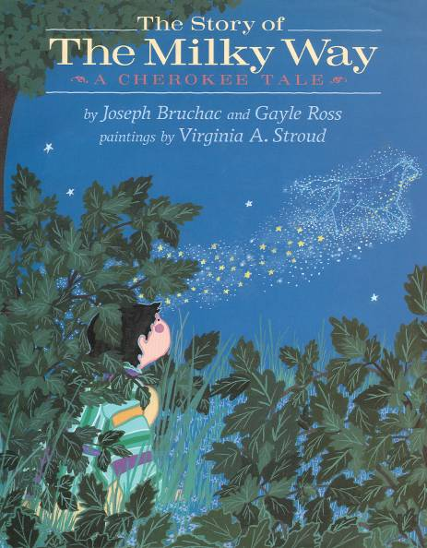
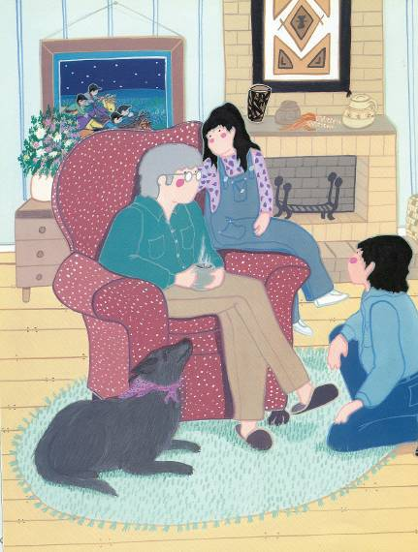
Book opens/closes with present-day family; a powerful visual that says ‘we are still here’

Slide 2
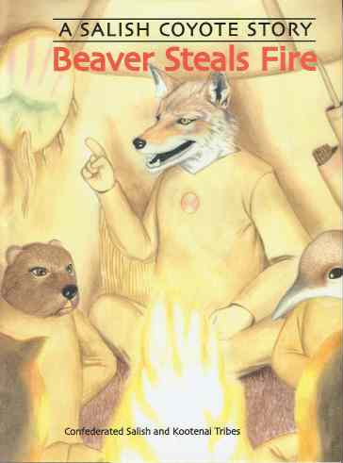
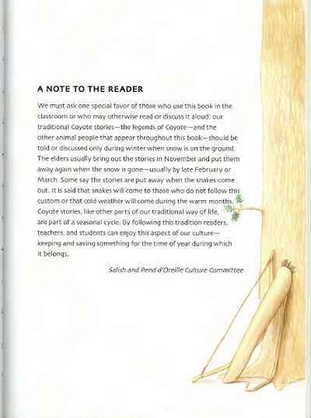
Tribes publishing their stories, with rich notes to the reader:

Slide 3
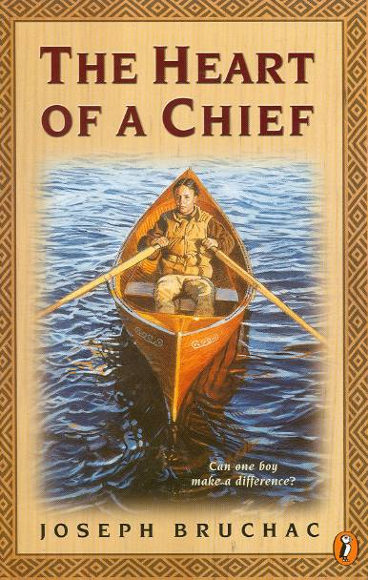
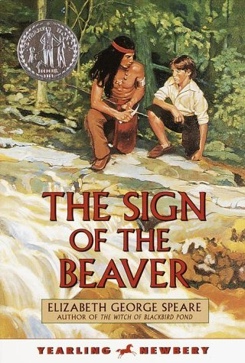
Bruchac story where protagonist in present-day classroom ‘speaks back’ to content in The Sign of the Beaver
Protagonist in The Heart of a Chief:
“The end of the book… At the end the Indians just go away.
But that isn’t what happened. We didn’t go away.
They tried to drive us off the land. They put bounties on our scalps. They burned our villages. But we didn’t go away.
We’re still here.”

Slide 4
Erdrich’s award-winning series of same period as Little House series, looks at cultures coming into contact with each other, but does not demonize ‘other’

Slide 5
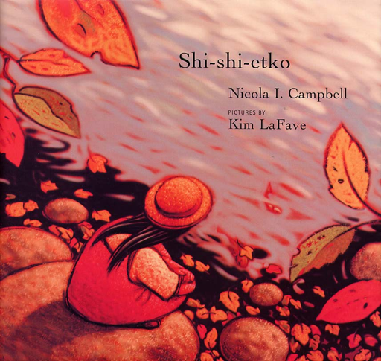
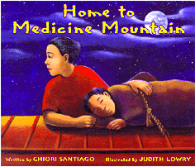
Picture books about boarding school, by Native artist/illustrators

