Slide 1
Better Choices! Here’s a look at some outstanding books.

Slide 2
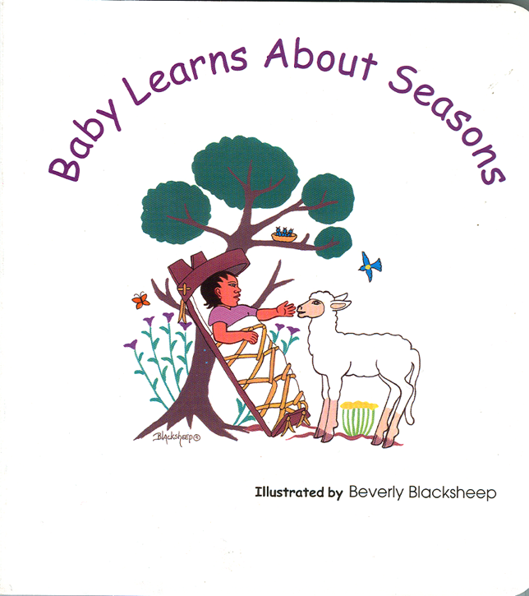
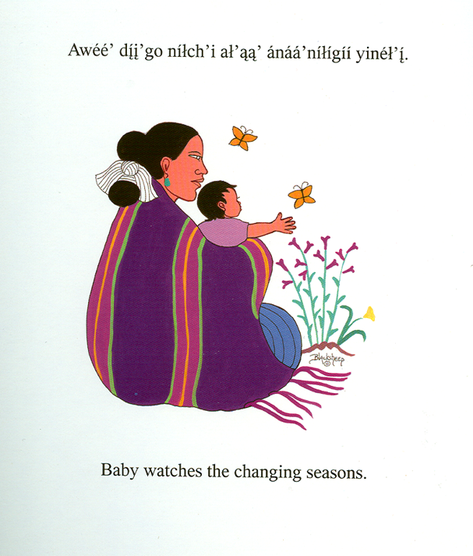
Bilingual board book series (English/Navajo) from Salina Press

Slide 3
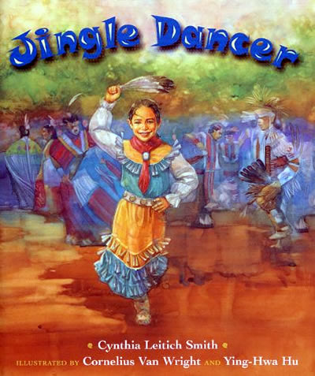
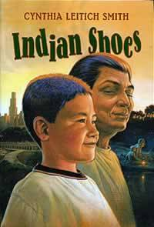
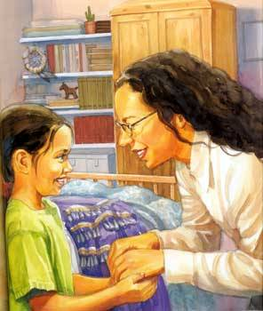
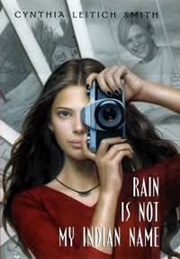
Cynthia Leitich Smith’s picture book, middle grade, YA:

Slide 4
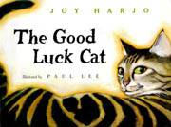
A cat story by Joy Harjo

Slide 5
Traditional Stories: Where are they shelved? With folktales? Or with world religions?

