Slide 1
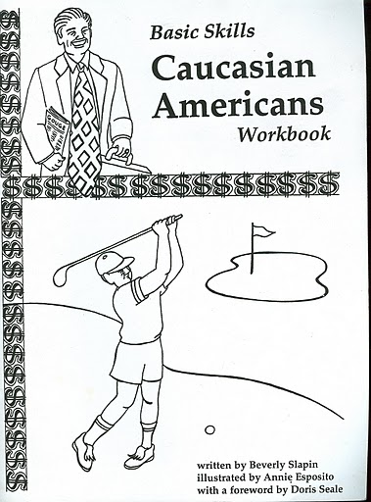
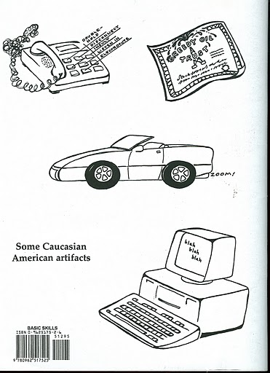
Develop a critical eye…

Slide 2
Strategy to become adept at selection of books by/about American Indians: Know one nation in-depth. Read its website, writers of fiction and nonfiction who are of that nation. Internalize that information! Your expertise will help you develop a critical eye that can spot problems in materials of other nations.

Slide 3
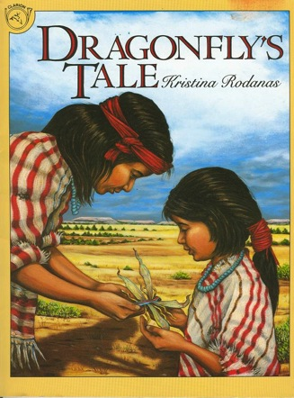
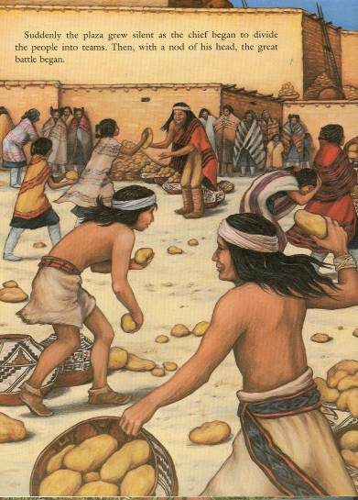
Example: Expertise in Pueblo traditions of “throw” (sharing of harvest) would help you spot problems in this book:

Slide 4
Example: Knowing about devastation wrought by boarding schools would help you recognize its misrepresentation
School Library Journal: “An excellent addition to a popular series.”
Booklist: “A solid addition to the Dear America series.”
Kirkus: “A strong addition to Rinaldi’s ongoing historical explorations.”
Scholastic, 1991

Slide 5
Example: Knowing facts about Indian Removal and Native culture would help you recognize problems in classics
1804: Indian Territory created
1845: almost 100,000 Choctaw, Cherokee, Chickasaw, Creek, Seminoles in Indian Territory
1866: Laura Ingalls born
1868: Charles Ingalls moves family to Indian Territory.

Slide 6
Resource that can help: Trail of Tears episode

Slide 7
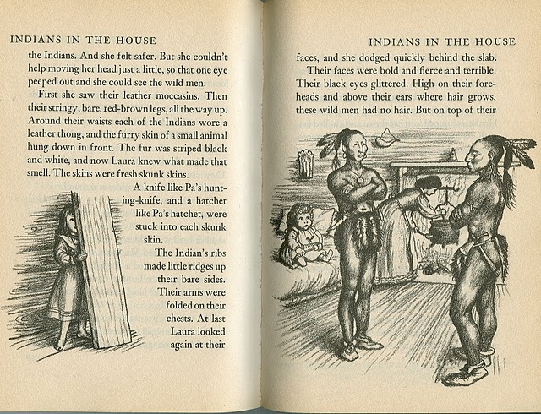
After watching video, study these pages:
p. 1
p. 6
p. 55 - 56
p. 122
p. 134 – 139
p. 211
p. 229
p. 290-291

Slide 9
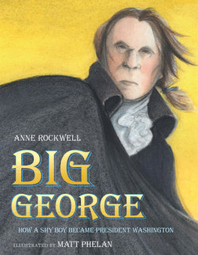
Nonfiction (bio)
Three hundred years ago, there was no United States of America. Instead, there were thirteen English colonies in North America.
Three hundred years ago, there was no United States of America. Instead, there were hundreds of Native Nations. Europeans who had fled Europe had come to North America and were occupying lands that belonged to the Native Nations. These Europeans set up thirteen English colonies.
Harcourt, 2008

Slide 10
Collection Development guides by Disher (2007) and Larson (2008) state books can be weeded on these criteria:
Misleading
Inaccurate
Racial Bias
Stereotyping
Balance

