Slide 1
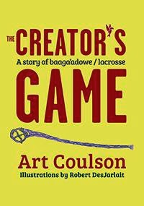
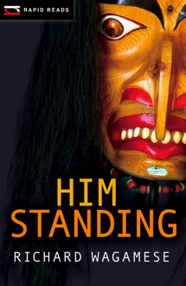
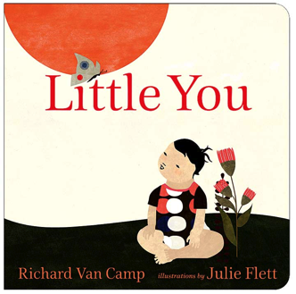
Small Publishers: 8 7 that are terrific (one not available)

Slide 2
Conclusion: In the sample, books from small publishers are more reliable (accurate, free of stereotypes) than books from large publishers.

