Slide 1
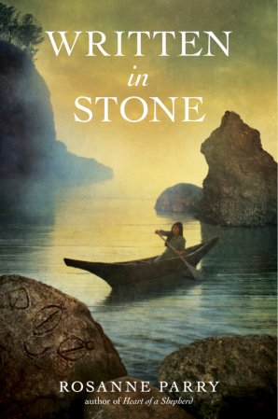
New book uses “Indian
Princess” stereotype.
Author created Native story
and petroglyphs to fit her
fiction.
The latter are author’s
creative license, but
there is already far too
much fiction that misrepresents
Native people.
Why add to it?

Slide 2
2013 Cooperative Children’s Book Center, University of Wisconsin
34 books by/about American Indians/First Nations
Reese analysis (research in progress)
First sample:
Fiction published in US, N=14

Slide 3
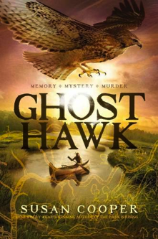
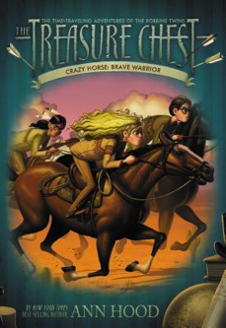
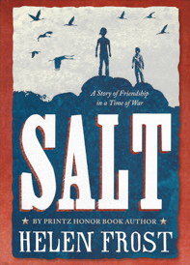
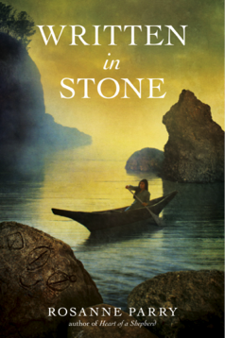
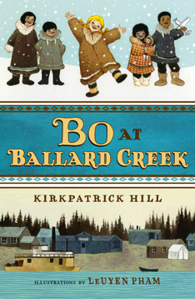
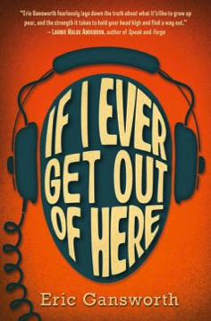
Major publishers: 6 books, 5 with serious problems

