Slide 1
INCOL 2014 American Indians (not) in Children’s and Young Adult Literature
Debbie Reese, PhD
American Indians in Children’s Literature

Slide 2
Thank you! dreese.nambe@gmail.com

Slide 3
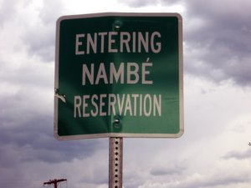
Native nations are sovereign!
Bounded land marked with signs
Drive too fast? Tribal police issue
ticket! Payable to tribe, contest
Before tribal judge.

Slide 4
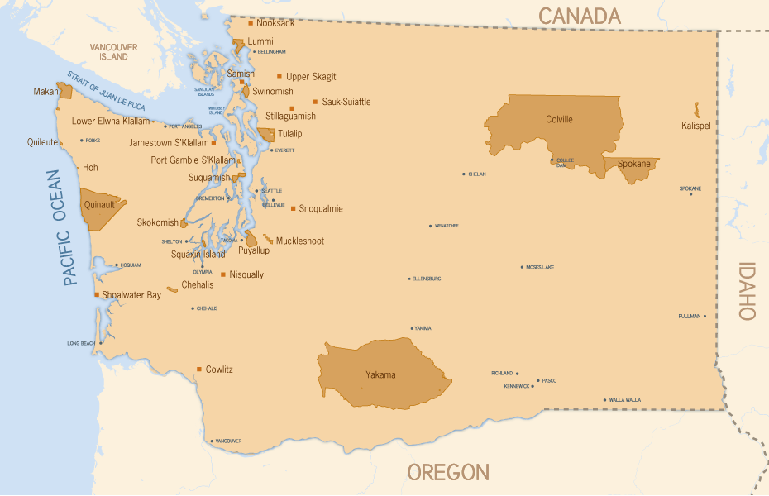

Slide 5
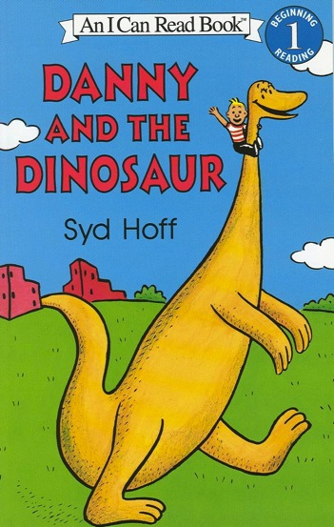
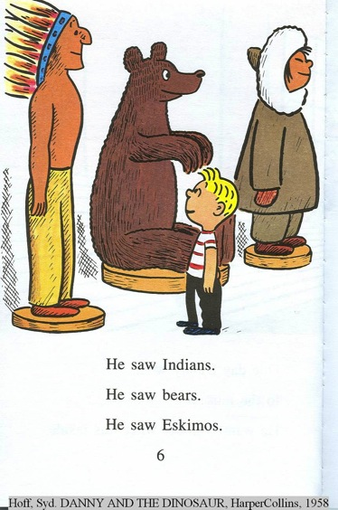
We remember books we read as young people, but generally don’t notice stereotypes:

Slide 6
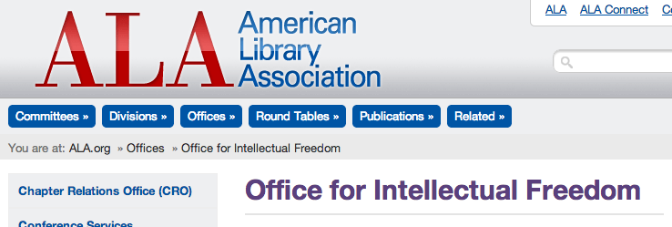
Use ALA offices to guide collection development

Slide 7
Research studies on impact of stereotypes:
1999: Brophy
2008: Fryberg, Marcus, Oyserman, Stone
2010: Tippeconnic and Faircloth
2012: Education Week

Slide 8
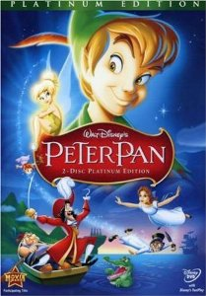
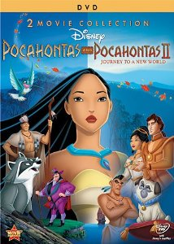
Disney videos?

Slide 9
Do you remember the song “What makes the red man red?” https://www.youtube.com/watch?v=Y_at9dOElQk

Slide 10
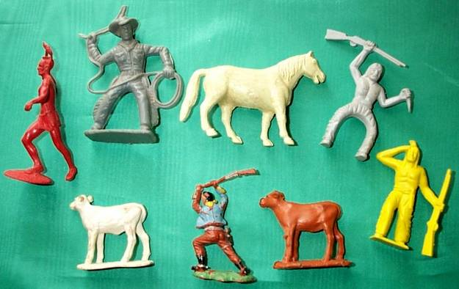
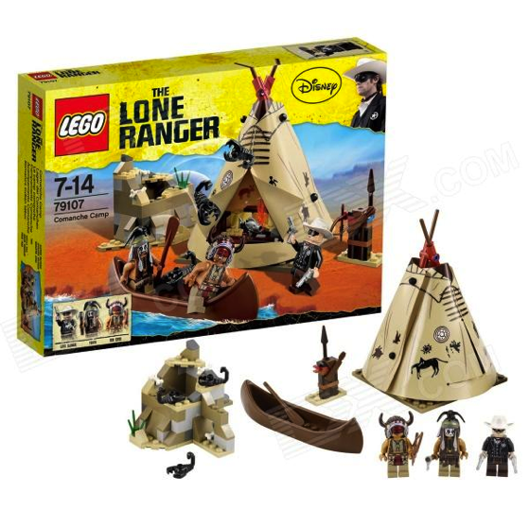
Toys

